Slide 1

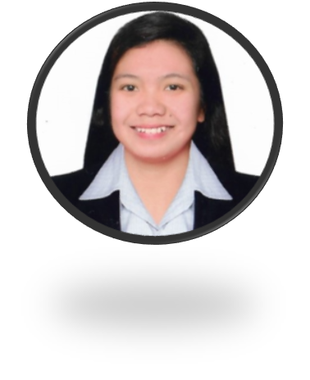



THE CONQUERORS
NATANAUAN, LEE-ANN JOY
CASABAL, MAEZIE
MANALO, JOHNREY
CASTILLO, NIELSEN
DIMAANDAL, LALAINE

Slide 2

COVID-19 DESCRIPTIVE ANALYSIS: UNEMPLOYMENT SITUATION IN THE PHILIPPINES

Slide 3
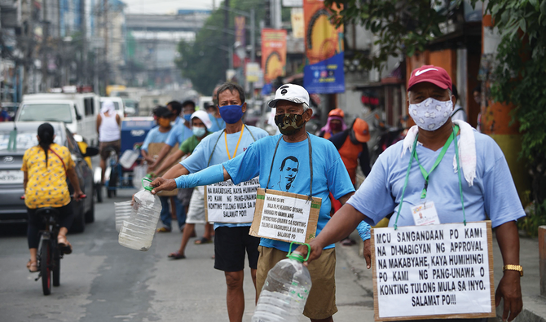
JEEPNEY DRIVER’S
WHO LOST
THEIR JOB DURING
THE PANDEMIC

Slide 4


SUSTAINABLE DEVELOPMENT GOALS

Slide 5
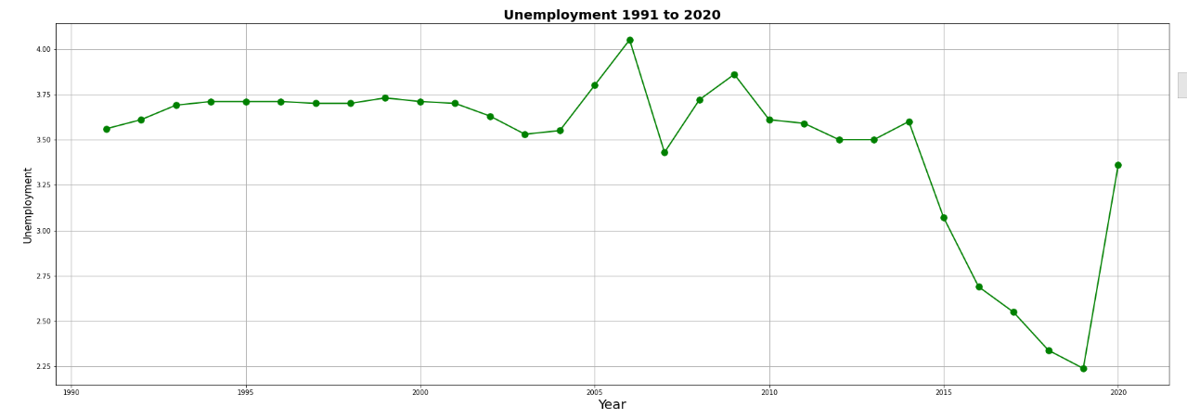
UNEMPLOYMENT IN PHILIPPINES
1991 - 2020

Slide 6
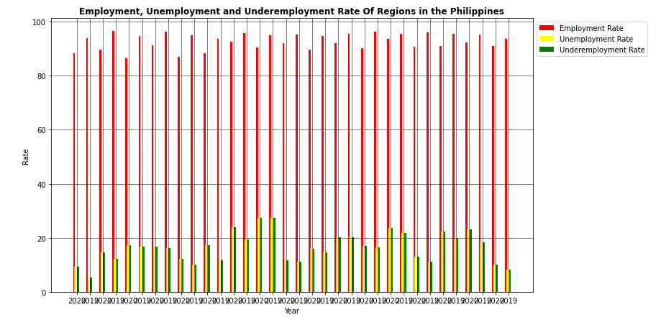
EMPLOYMENT, UNEMPLOYMENT AND UNDEREMPLOYMENT RATE OF REGIONS IN THE PHILIPPINES

Slide 7
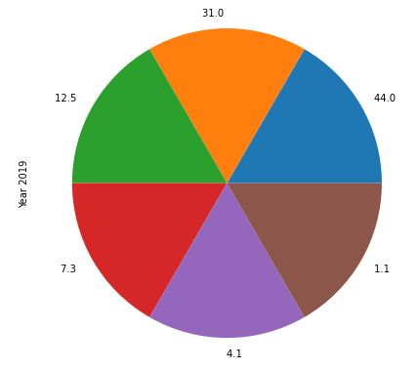
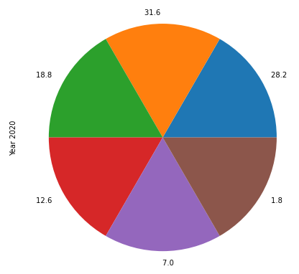
COMPARISONS OF AGES OF UNEMPLOYED PEOPLE IN YEAR 2019 - 2020

Slide 8
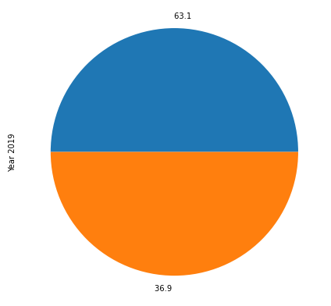
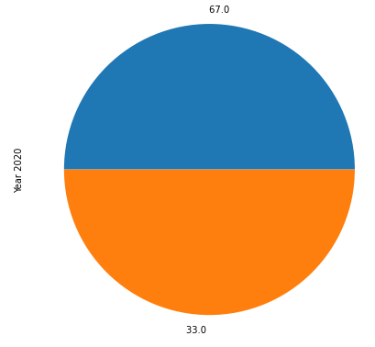
COMPARISONS OF GENDER OF UNEMPLOYED PEOPLE IN YEAR 2019 - 2020

Slide 9
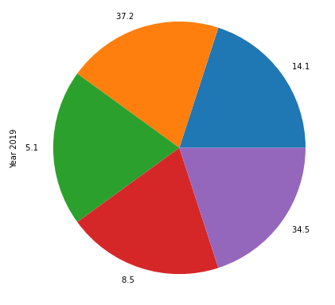
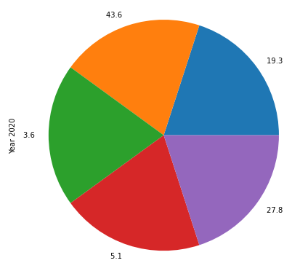
COMPARISONS OF EDUCATION OF UNEMPLOYED PEOPLE IN YEAR 2019 - 2020

